Slide 1



Quantum Integrated Services
FY20Q4-SA CSG-Dell Indo Cons-Inspiron DT 22NM POSM

Slide 2
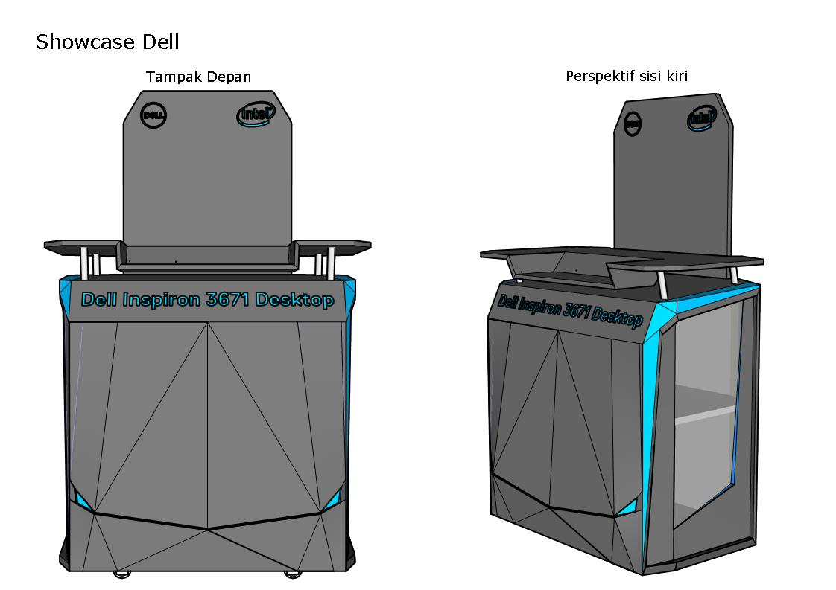
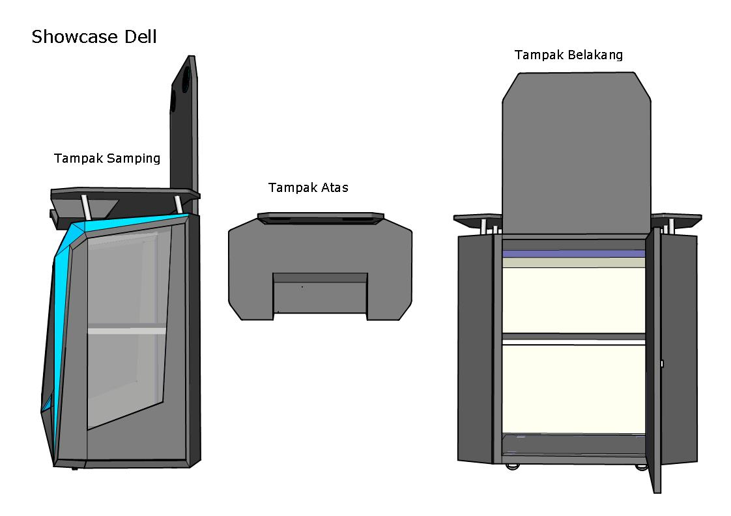
Design

Slide 3
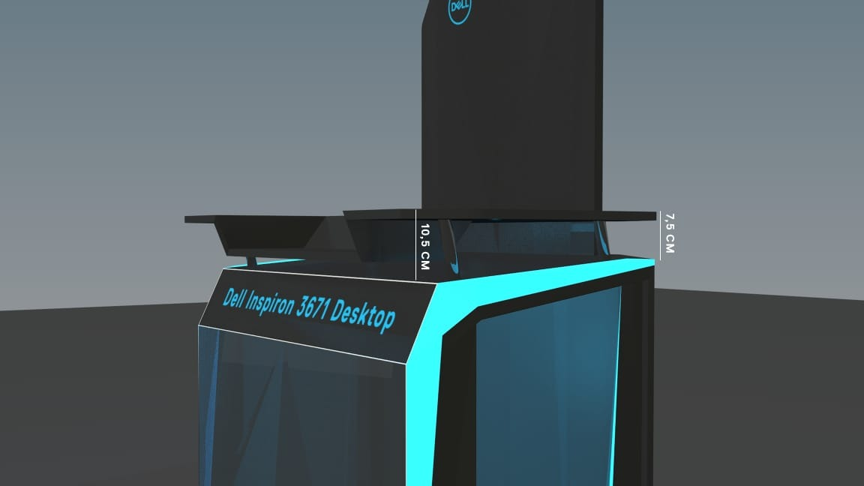
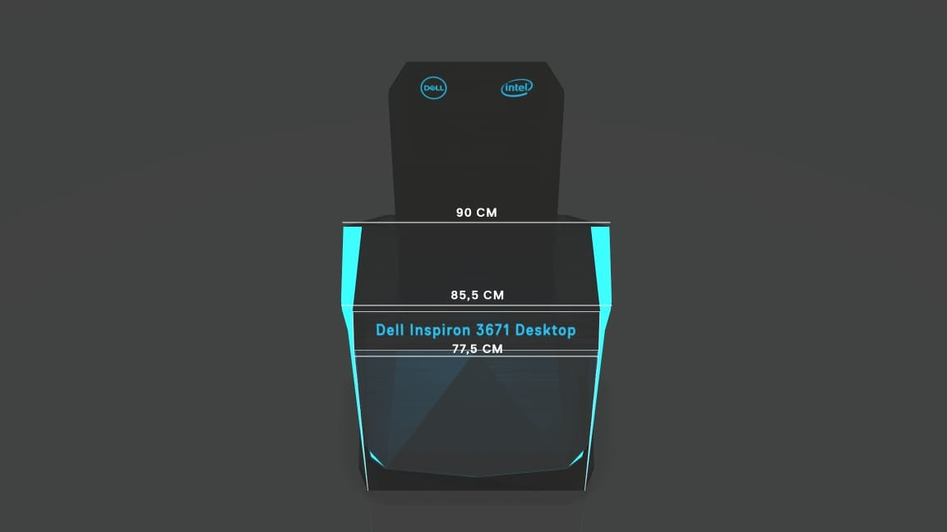
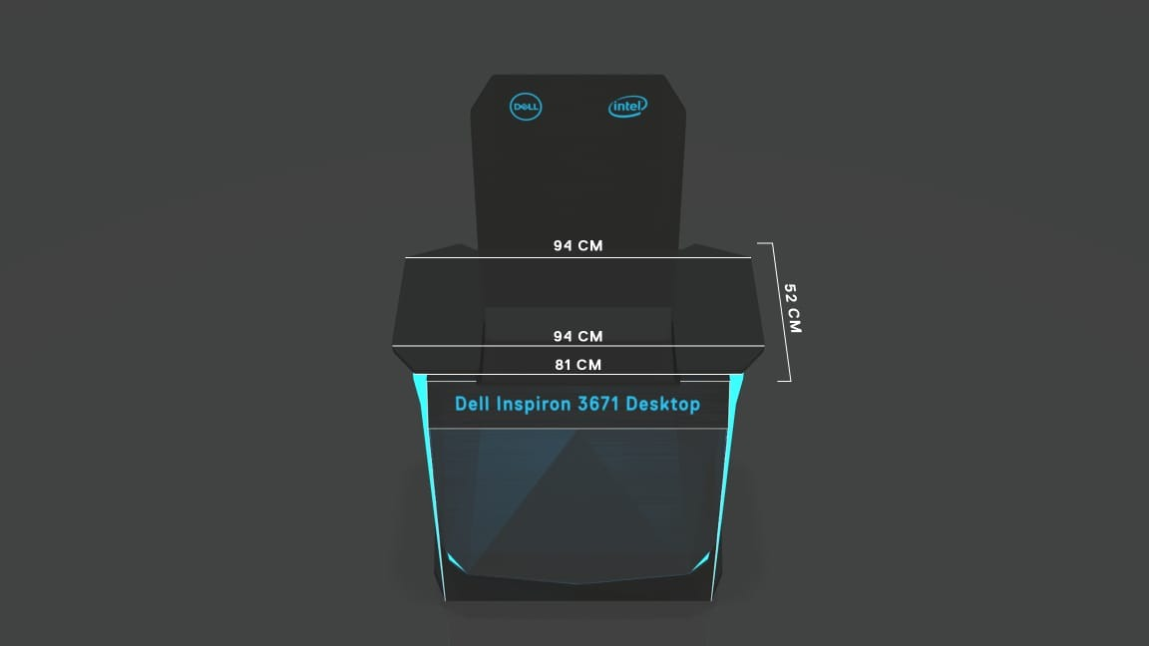
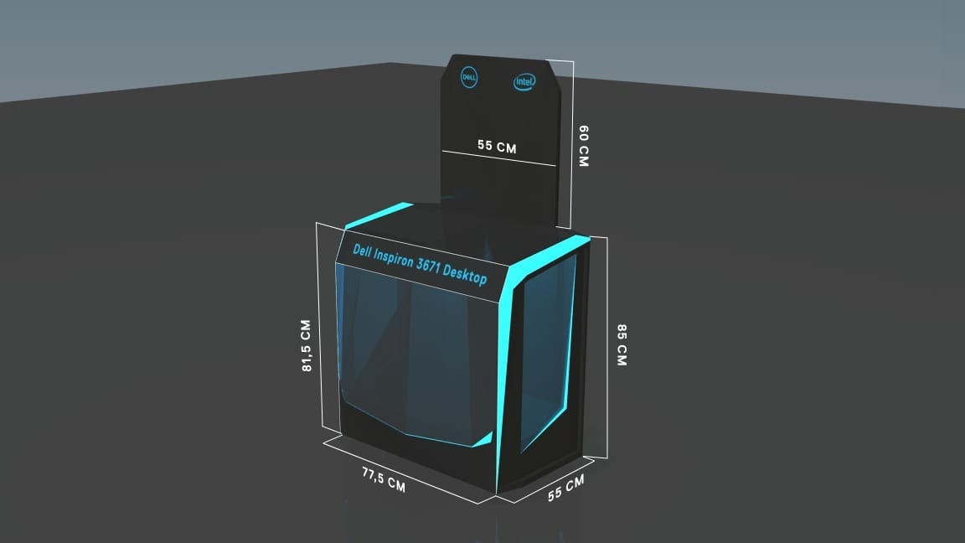
Size
8,11cm X 8,11cm
9,74cm X 6,39

Slide 4
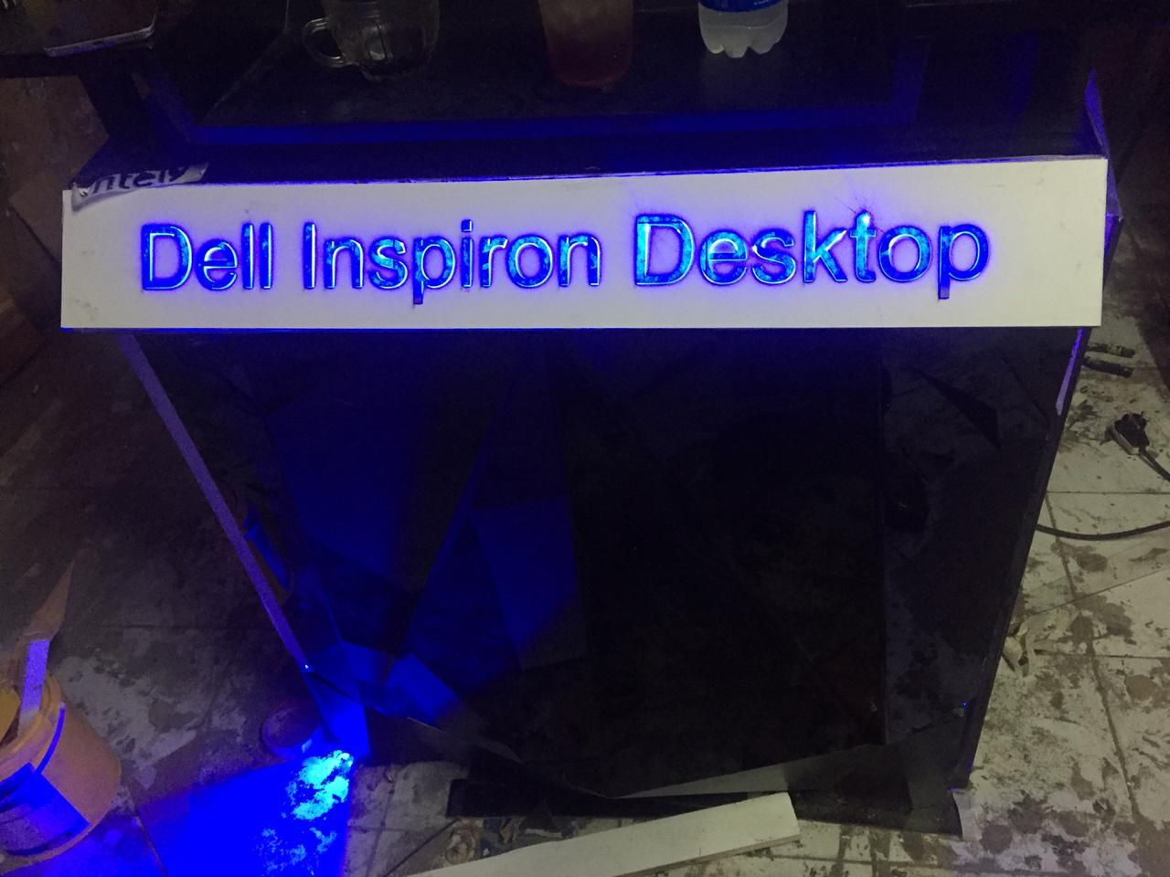
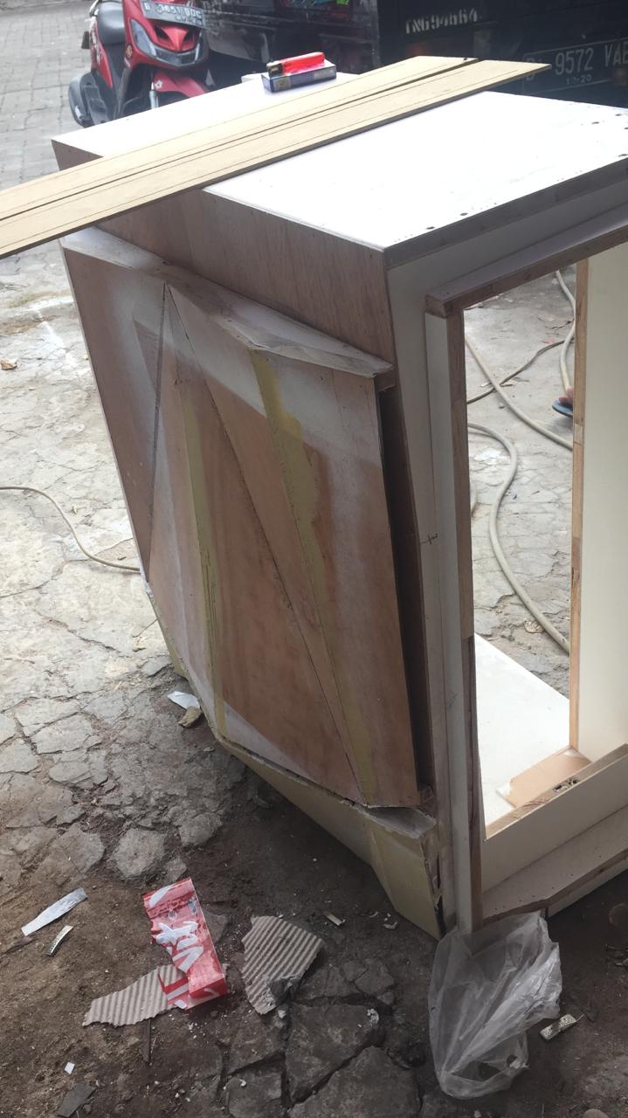
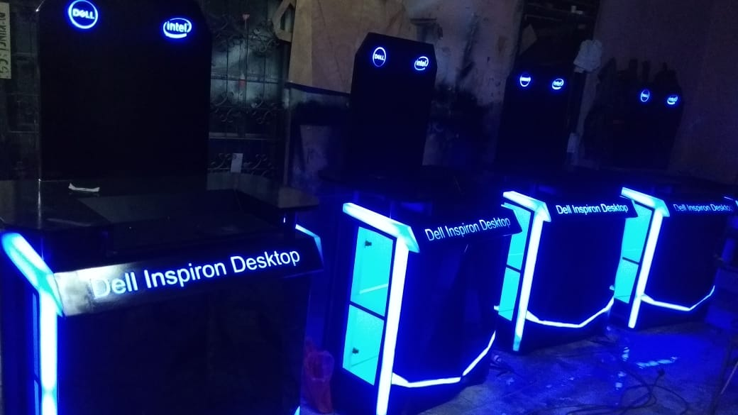
Production

Slide 5
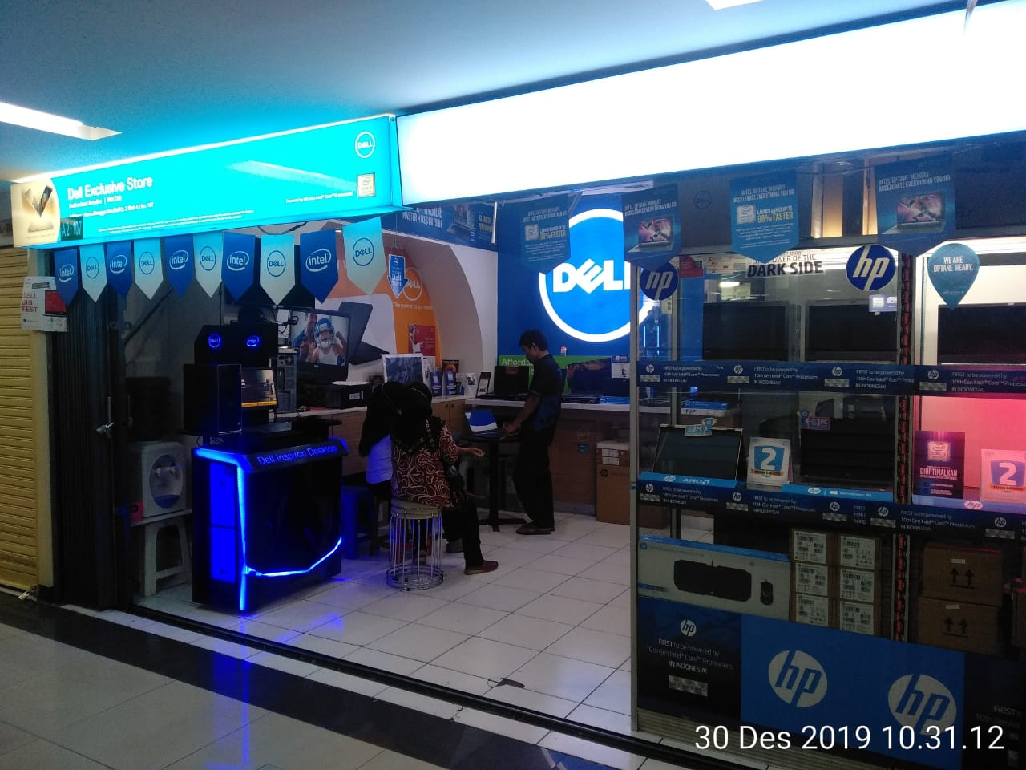
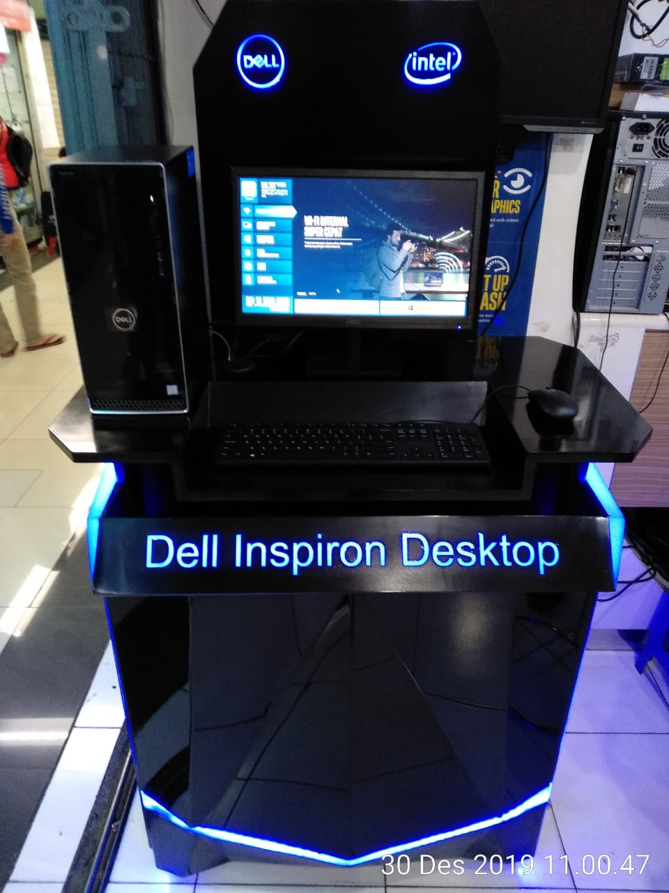
Nama Toko | Visi Inti Sinergi / Viscom
Alamat | Harco Mangga Dua Blok A Lt. 2 No 107 , Jakarta

Slide 6
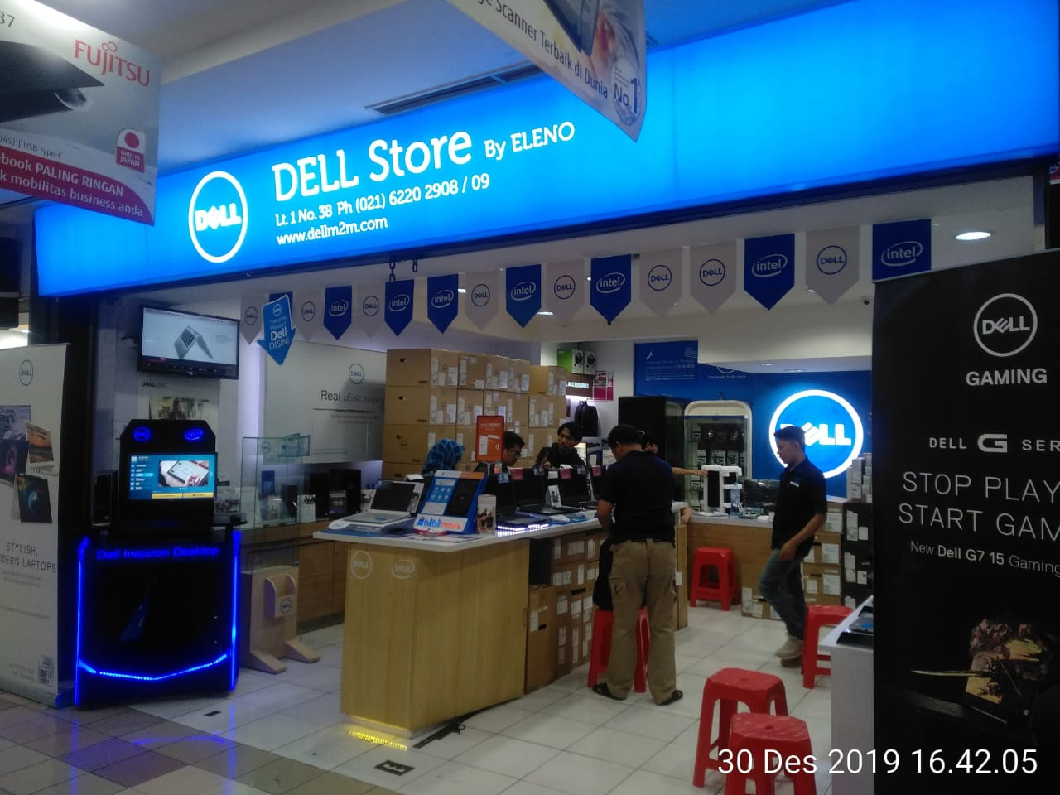
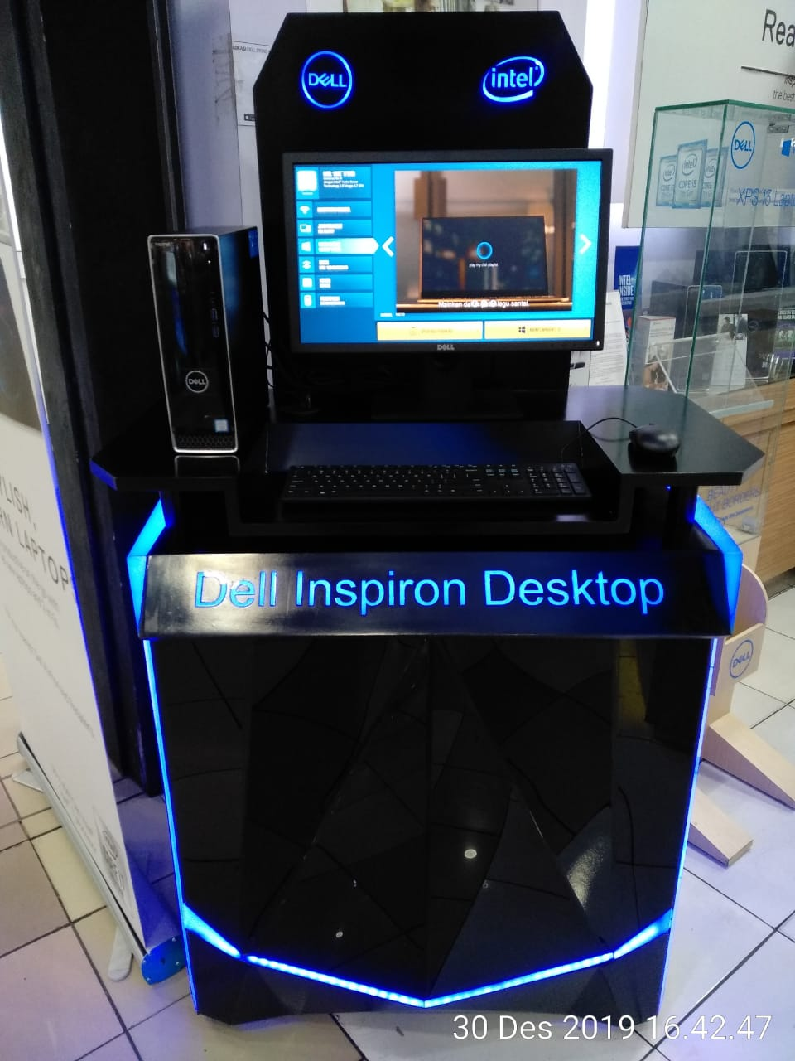
Nama Toko | ELENO
Alamat | Mangga Dua Mall - Lt. 1 No. 38, Jakarta

Slide 7
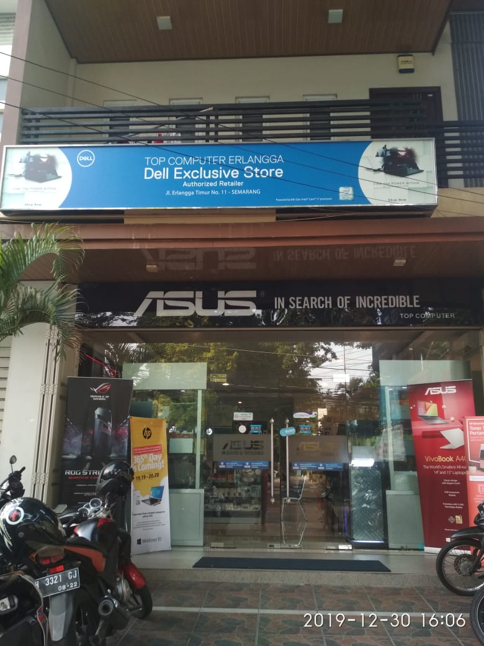
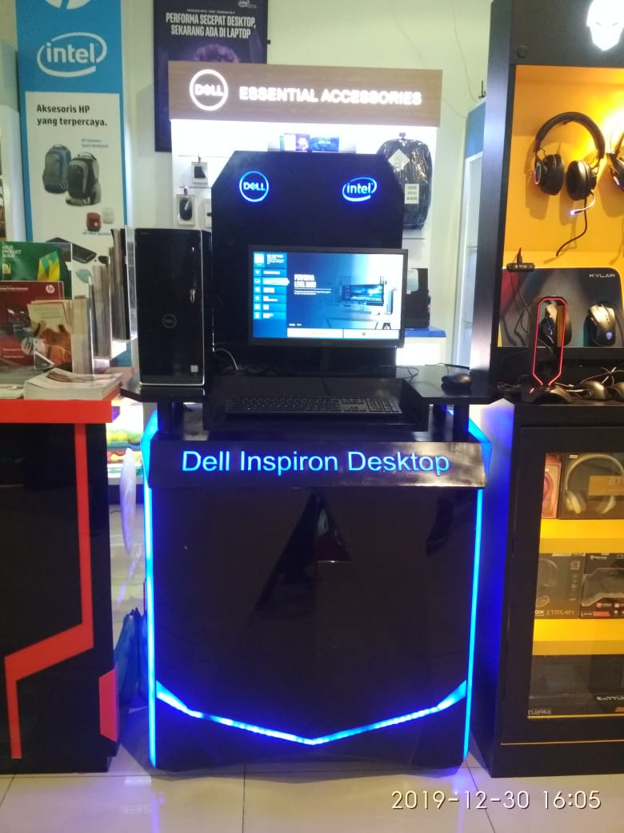
Nama Toko | TOP COMPUTER
Alamat | Jl. Erlangga Timur No. 11, Semarang

Slide 8
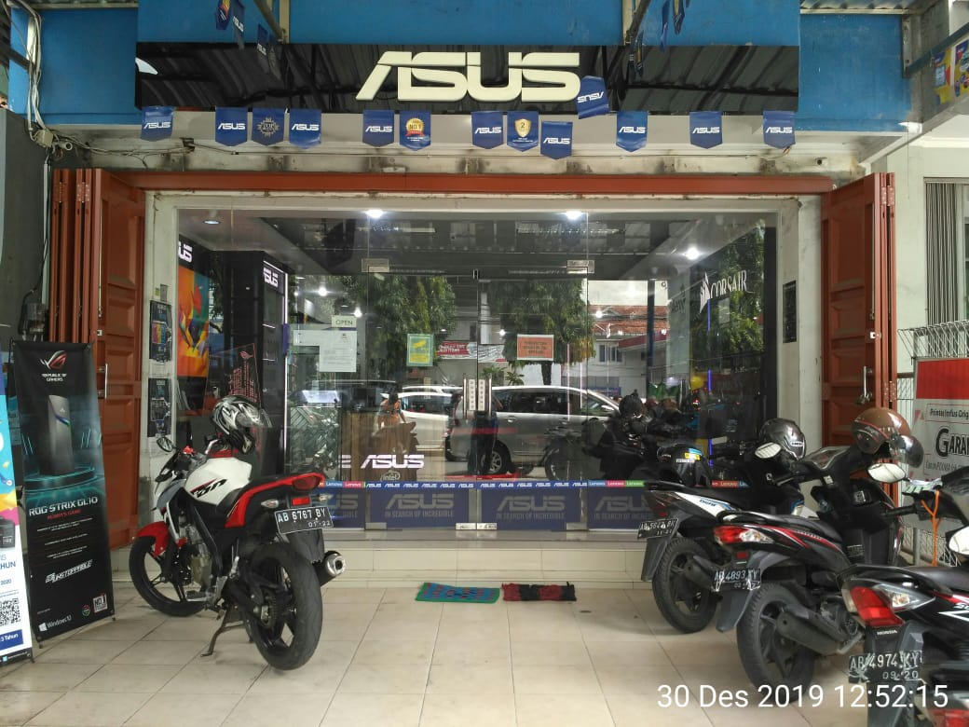
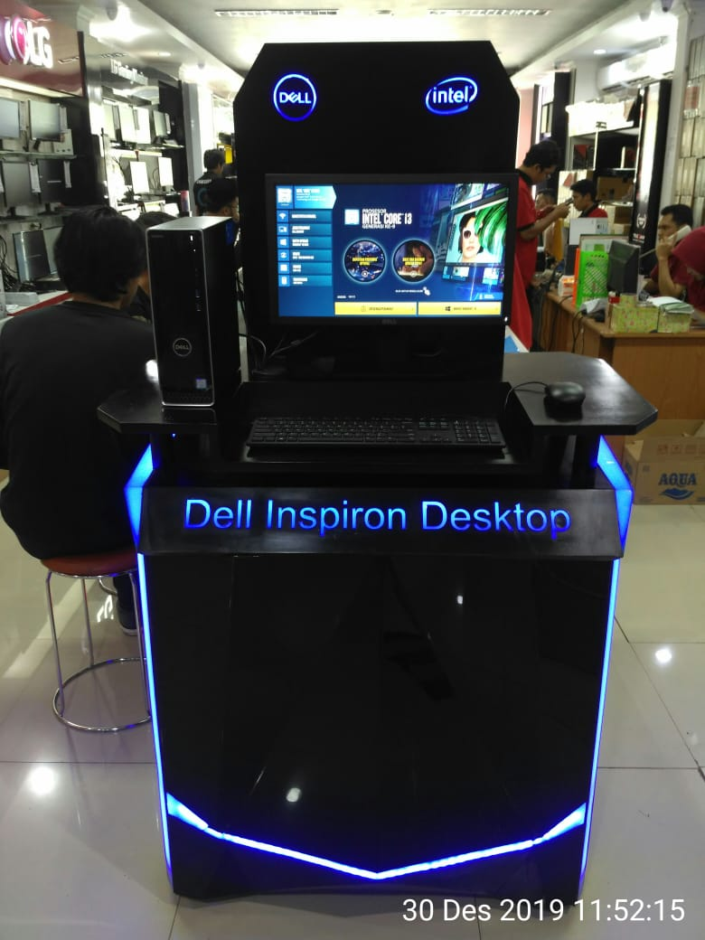
Nama Toko | Annisa Comp
Alamat | Jl. Soropadan RT 01/36 Depok, Sleman, Yogyakarta

Slide 9
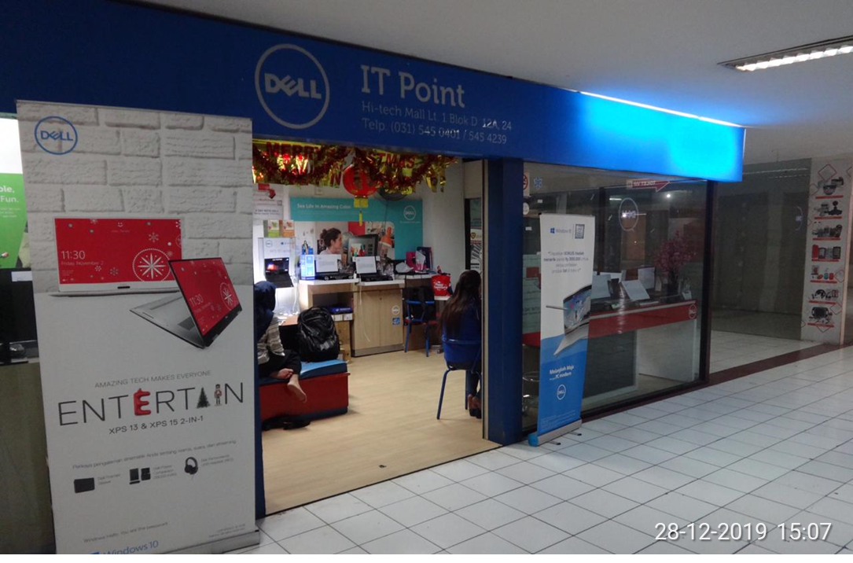
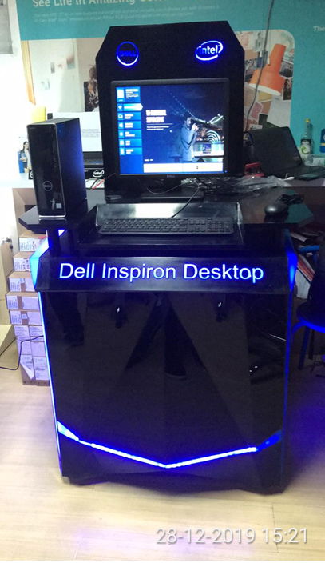
Nama Toko | IT Point / PC Master
Alamat | Hi-Tech Mal Lt. 1 Blok D 12A, 24 Surabaya

Slide 10
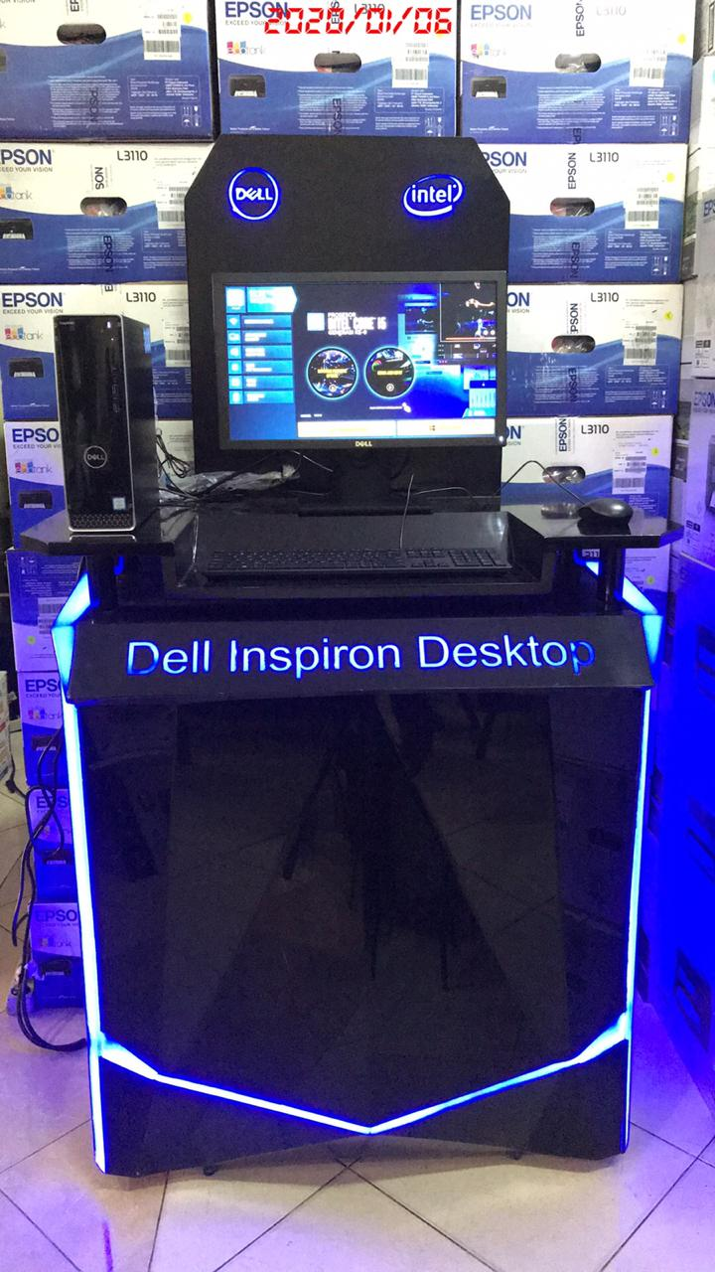
Nama Toko | ACK Surabaya
Alamat | Manyar Rejo 17A, Surabaya
Note:
The Showcase has been delivered to ACK Office, due the store closed until 5 January 2019.
email confirmation as attached

Slide 11
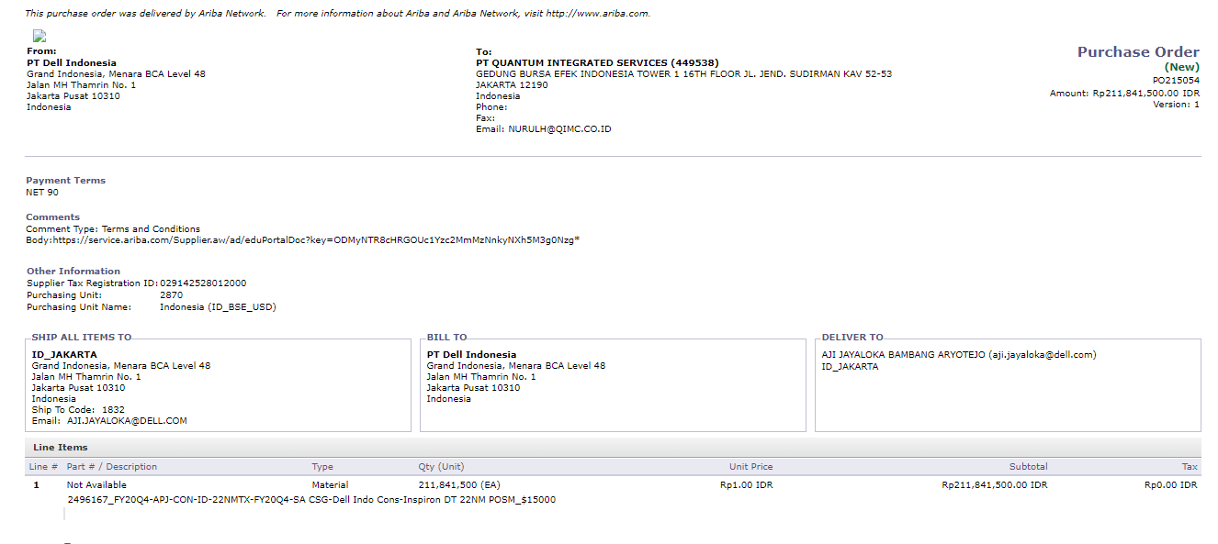
PO

Slide 12
Invoice Breakdown

Slide 13



